Slide 1
Leadership for Patient Safety
Tejal Gandhi, MD, MPH, CPPS
President & CEO
Patricia McGaffigan, RN, MS
Chief Operating Officer & Senior Vice President, Programs
National Patient Safety Foundation

Slide 2

Institute of Medicine’s 1st quality report:
To Err Is Human – November 1999
Preventable lapses in safety:
44,000 to 98,000 Americans die each year
Eighth leading cause of death in the
United States
Annual cost as much as $29 billion annually
Conclusion: the majority of these problems are systemic, not the fault of individual providers

Slide 3

Free from Harm – December 2015
Download the full PDF report for free at:
www.npsf.org/free-from-harm
Thank you to AIG for their generous support of this project

Slide 4
Endorsing Organizations
American Academy of Nursing American Association for Physician Leadership American Association of Critical-Care Nurses American Nurses Association Anesthesia Patient Safety Foundation Association of periOperative Registered Nurses Aurora Health Care Baptist Easley Hospital Carolina Pines Regional Medical Center | Children’s Hospitals’ Solutions for Patient Safety (SPS) Cincinnati Children’s Hospital Medical Center Citizens for Patient Safety Collaborative Latin America Forum in Quality and Patient Safety College of Healthcare Information Management Executives CoxHealth Emergency Medicine Patient Safety Foundation Hampton Regional Medical Center

Slide 5
Endorsing Organizations continued
HIMSS Hospital Quality Institute Institute for Clinical Effectiveness and Health Policy (IECS) Institute for Healthcare Improvement Institute for Safe Medication Practices John D. Stoeckle Center for Primary Care Innovation Massachusetts Coalition for the Prevention of Medical Errors Medical University of South Carolina Memorial Hermann Health System MHA Keystone Center Minnesota Alliance for Patient Safety | National Association for Healthcare Quality Oregon Patient Safety Commission Pacific Business Group on Health Society of Hospital Medicine Society to Improve Diagnosis in Medicine Spartanburg Regional Healthcare System The Task Force for Global Health Tennessee Hospital Association Tidelands Health Trident Health

Slide 6
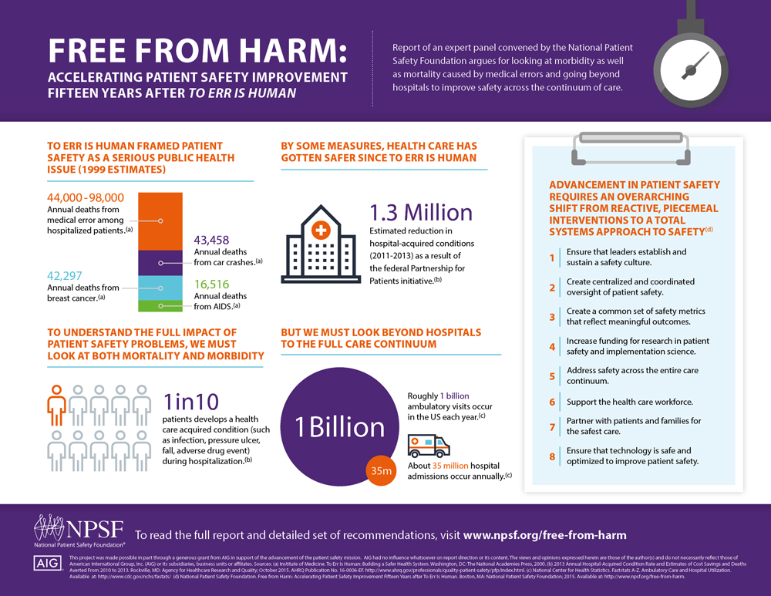

Slide 7
Current State of Patient Safety
Evidence mixed but panel overall felt that health care is safer but there is more work to be done
While limited, progress notable
  Young field
  Still developing scientific foundations
  Received limited investment
Improving patient safety is a complex problem
  Requires work by diverse disciplines to solve

Slide 8
Total Systems Approach Needed
Advancing patient safety requires an overarching shift from reactive, piecemeal interventions to a total systems approach
Need to embrace wider approach beyond specific, circumscribed initiatives to generate change
Fundamental finding: Initiatives can advance only with a key focus on teamwork, culture and patient engagement

Slide 9
Eight recommendations for achieving
Total Systems Safety
1. Ensure that leaders establish and sustain a safety culture
2. Create centralized and coordinated oversight of
patient safety
3. Create a common set of safety metrics that reflect meaningful outcomes
4. Increase funding for research
in patient safety
and implementation science
Improving safety requires an organizational culture that enables and prioritizes safety. The importance of culture change needs to be brought
to the forefront, rather than taking a backseat to other
safety activities.
Optimization of patient safety efforts requires the involvement, coordination, and oversight of national governing bodies and other safety organizations.
Measurement is foundational
to advancing improvement.
To advance safety, we need
to establish standard metrics across the care continuum
and create ways to identify and measure risks and
hazards proactively.
To make substantial
advances in patient safety, both safety science and implementation science should be advanced, to more completely understand safety hazards and the best ways
to prevent them.

Slide 10
Eight Recommendations for Achieving Total Systems Safety
Eight recommendations for achieving
Total Systems Safety
5. Address
safety across the entire care continuum
6. Support
the health care workforce
7. Partner with patients and families for
the safest care
8. Ensure that technology is
safe and optimized to improve
patient safety
Workforce safety, morale, and wellness are absolutely necessary to providing safe care. Nurses, physicians, medical assistants, pharmacists, technicians, and others need support to fulfill their highest potential as healers.
Patients deserve safe care in and across every setting. Health care organizations need better tools, processes, and structures to deliver care safely and to evaluate the safety of care in various settings.
Patients and families need to be actively engaged at all levels of health care. At its core, patient engagement is about the free flow of information to and from
the patient.
Optimizing the safety benefits and minimizing the unintended consequences of health IT is critical.

Slide 11
In summary…
Much has improved but too much remains the same
  Failure to make substantial, measurable, system-wide strides in improving patient safety
Safety must be a top priority as a public health issue
Eight recommendations outline a framework
Must accelerate efforts to create a world where patients and those who care for them are free from harm

Slide 12
Board Members, CEOs and Safety:
Highlights from an NPSF Survey
Goal: Survey Board Members (BdM) & CEOs with respect to safety and quality
  Leadership practices, knowledge, and understanding
Safety, quality, risk leaders (SQLs) also surveyed; rated their perceptions of what they think BdM & CEOs know and understand

Slide 13
Methods
Design: ROL to benchmark related surveys; designed with safety experts & executives
Convenience survey; 36 questions
Invitations emailed 2014: NPSF email lists, SPS National Network CEOs, purchased list of BdM
Responses: 105 BdM and 53 CEOs
Analysis
  Compared BdM with CEOs
  Patterns and degrees of gaps; low & high ratings

Slide 14
Board Practices (% saying “Yes”)
My board… | BdM | CEO
PS/Q plan developed and shared with me in my governance role | 95 | 94
Board has an agenda item and discussion related to PS at ALL board meetings | 87 | 80
PS & Q dashboard at every board meeting | 70 | 61
PS events that result in harm are discussed at all board meetings | 42 | 37
Workforce safety dashboard at every board meeting | 31 | 8

Slide 15
Patients & Families (% saying “Yes”)
My organization… | BdM | CEO
Regularly evaluates/discusses Pt/Fam satisfaction surveys | 91 | 88
Regularly uses Pt/Fam stories | 72 | 63
Regularly evaluates and discusses Pt/Fam engagement surveys | 55 | 29
Engages with PFAC | 52 | 63
Has representation by Pt/Fam on committees | 52 | 49
Has at least 1 Pt/Fam member on its Board | 41 | 43

Slide 16
Safety Concepts (% responding “High”)
I know and understand… | BdM | CEO
Role of board in overseeing events of harm | 75 | 85
Disclosure and apology | 64 | 89
The process for/evaluation of RCAs for errors/harm | 63 | 80
Just culture | 58 | 83
Transparency/communication of errors and harm with patients/families | 56 | 83
High Reliability Organizations (HRO) | 47 | 70
Transparency/communication of errors and harm with public | 40 | 57

Slide 17
Workforce (% responding “High”)
I know and understand… | BdM (%) | CEO (%)
Employee satisfaction surveys | 80 | 96
Culture of safety surveys | 60 | 85
Workforce safety challenges (physical and emotional) | 56 | 72
Employee turnover | 56 | 85
Employee injury rates and safety reports (physical/emotional) | 55 | 65
Workforce safety dashboards | 50 | 50
Workmen’s compensation rates | 23 | 46

Slide 18
Limitations
Low response rate
Sample bias
Unpaired cohorts
No clear understanding of what boards & CEOs need to know
No data on actual organizational performance other safety metrics (culture surveys, HCHAPS)

Slide 19
Recommendations
Further analysis on core competencies of leaders
  We do not know what leaders need to know and do
  Results may provide a compass for future focus
  Workforce safety, patient / family engagement, board practices, high reliability, transparency
Expanded research with paired cohorts across same organizations and organizational performance metrics

Slide 20
Conclusion
It is a leadership imperative to understand, create, and sustain total systems and cultures of safety
Clear recommendations for total systems approach to safety
Shaping our leaders to be “culture definers, owners, and carriers” is critical
More research, resources, and collaboration is needed for scalability and spread

